Slide 1
Enterprise “Knowledge Graphs“ when "Web of Data" technologies make a lot of sense in business scenarios.
Dr. Giovanni Tummarello FBK- Italy
Sindicetech - Ireland
ICSC 2014
16/6/2014
Notes:
S

Slide 2
Background Sindice.com (2007-end of 2011)
Pushing search engine tech to the Web of Data

Slide 3
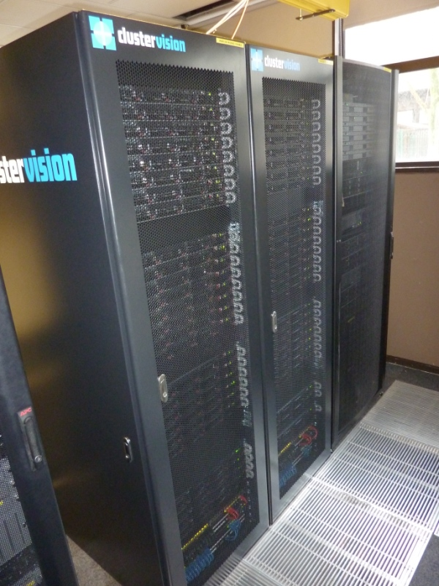
How we started: Sindice.com
Goal: building and experimenting with a “Centralized Semantic Web infrastructure”
Started with 1 machine , funded for 40 in 2008.
Stopped crawling 2012 - 5TB RDF indexed, 700M pages, ~30B triples

Slide 4
Sindice.com pipeline sketch
Analytics
Sparql
Sitemap Logic
Crawler
Data Staging
Extraction
Enhancement
HBase
Cache API
“Pings”
Siren

Slide 5
Technical milestones (Sindice.com)
Web of Data acquisition
Semantic Sitemaps [6], and best leverage of traditional sitemaps
Started and open-sourced Any23.org (Now an Apache top level project!)
Enrichment/Web Scale Reasoning
Full reasoning materialized before indexing, reasoning done fetching properties and ontologies online, partial reasoning results reused made it efficient, hadoop driven [3]
Big Data RDF processing/Analytics [4]
Semistructured Information Retrieval
Siren [1], Ding Ranking, BM25MF [5]
UI, Open Web of Data interaction paradigm
Sig.Ma [2] http://sig.ma
Sindice Site Services → unpublished, but see later slides
Cited/used in about 1100 studies
[1] R. Delbru, S. Campinas, G. Tummarello. Searching Web Data: an Entity Retrieval and High-Performance Indexing Model. Journal of Web Semantics, 2011. [2] G. Tummarello, R. Cyganiak, M. Catasta, S. Danielczyk, R. Delbru, S. Decker. Sig.ma : Live views on the Web of Data. In Journal of Web Semantics, 2010 [3]. R. Delbru, G. Tummarello, A. Polleres. Context-Dependent OWL Reasoning in Sindice - Experiences and Lessons Learnt. International Conference on Web Reasoning and Rule Systems (RR). 2011. [4] S. Campinas, T. E. Perry, D. Ceccarelli, R. Delbru and G. Tummarello. Introducing RDF Graph Summary With Application to Assisted SPARQL Formulation. (DEXA). Vienna, 2012.]
[5] Campinas, R. Delbru, G. Tummarello. Effective Retrieval Model for Entity with Multi-Valued Attributes: BM25MF and Beyond. EKAW 2012. [6] R. Cyganiak, H. Stenzhorn, R. Delbru, S. Decker and G. Tummarello. Semantic Sitemaps: Efficient and Flexible Access to Datasets on the Semantic Web. ESWC. 2008.

Slide 6
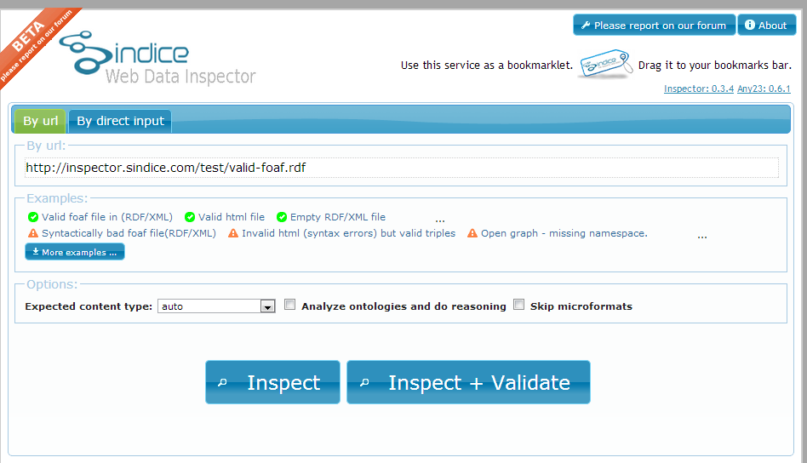
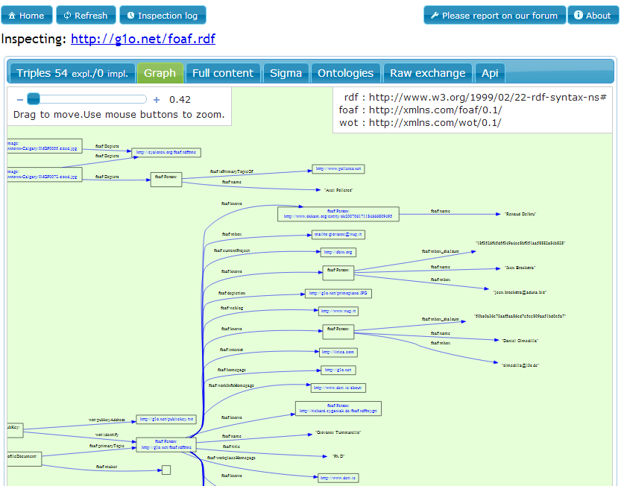
Sindice.com for “data webmasters” (1)
Individual page markup inspector
Full website markup inspector
Powered by Hadoop analytics, Sindice “Web Linkage Validator” shows data as a whole per website. Emphasis is on interconnection between entities both within the same site (but on different pages) and across websites/datasets. The “Sindice Summary graph” is 600+M triples itself. Try it here http://demo.sindice.net/dataset/

Slide 7
Sindice.com for “data webmasters” (2)

Slide 8
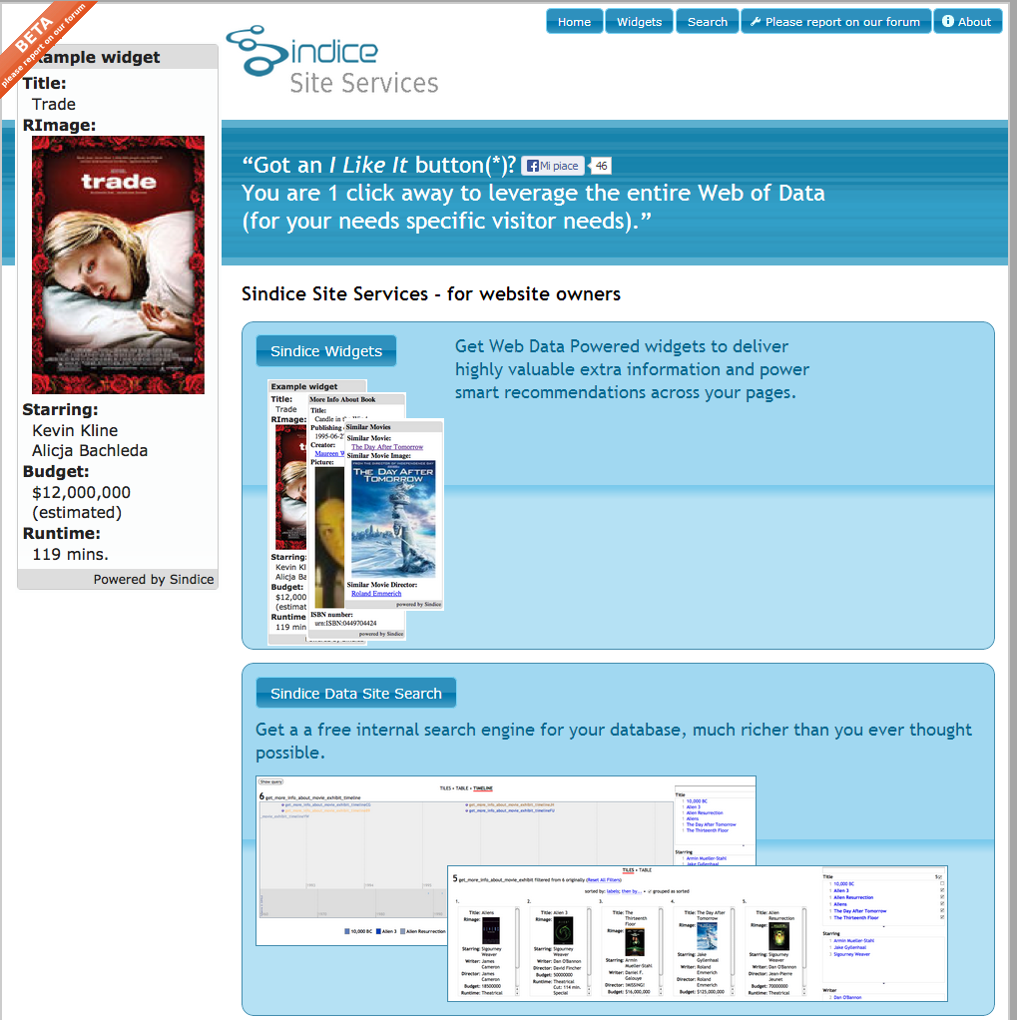
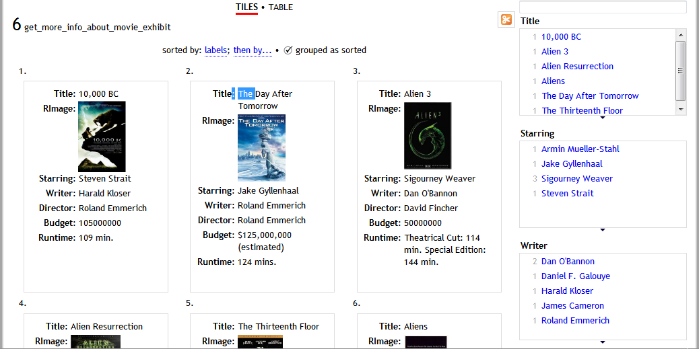
Sindice.com some applications
Sindice “Site Services” (POC): Put simple markup → Get data powered widgets and site search!
Sig.ma Sindice based mashups on the fly.

Slide 9
End of 2011
Schema.org booming
Web of Data “launched” as mainstream
Team quite interested in having impact and spinning off
Sindice.com → not a clear business model
Sindice Technologies, on the other hand started receiving direct attention from enterprises.
“You guys handle TBs of RDF, can you do the same behind a corporate the firewall”?
Sindice Technologies had ther own life!

Slide 10
Sindice(Tech) 2011-today
Enterprise Linked Data Clouds

Slide 11
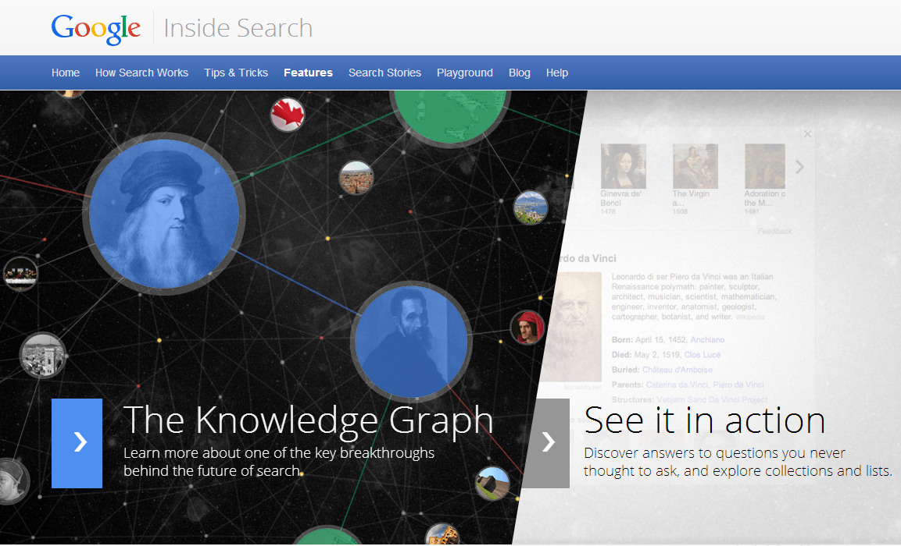
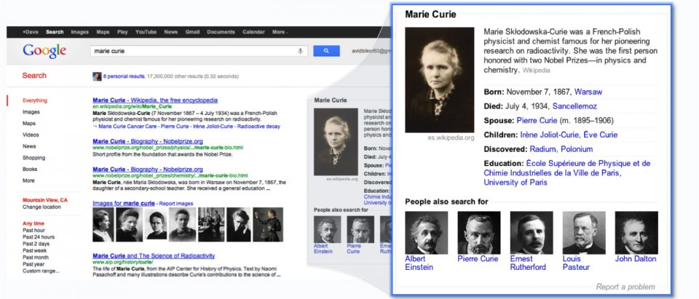
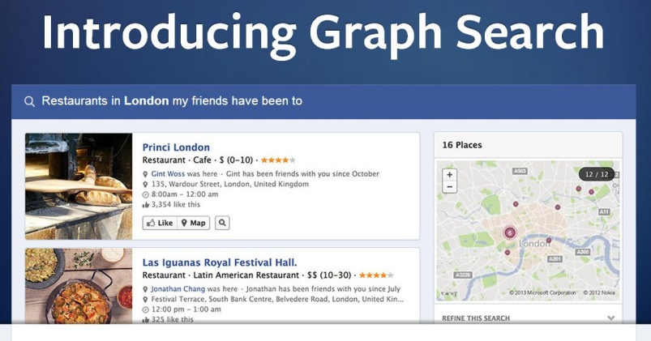
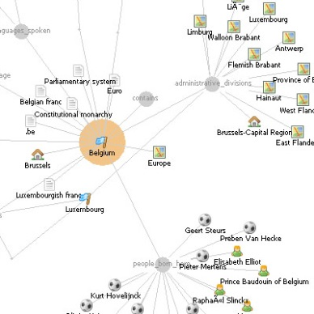
What is a “Knowledge Graph”?
See excellent Google introduction:
See also http://semanticweb.com/at-semtechbiz-knowledge-graphs-are-everywhere_b37724

Slide 12
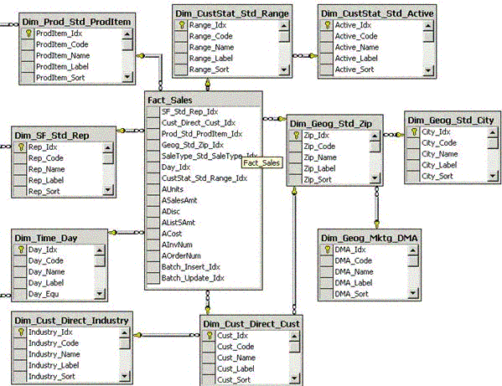
The Chasm in Knowledge Integration
Challenge
Variety:
Different context and business needs
Variability:
schema diversity semistructured data
Velocity:
the speed of data
Volume
SQL
Hadoop and NoSQL
Smart Content
Big Data
Logical Data Warehouse

Slide 13
Enterprise Knowledge Graphs
Graph Based - “No Schema”
Add first, pay asa you go understand and use later.
Made for Variety/Variability: 10+ year/ 1Be+ research
Variety:
Different context and business needs
Variability:
schema diversity semistructured data

Slide 14
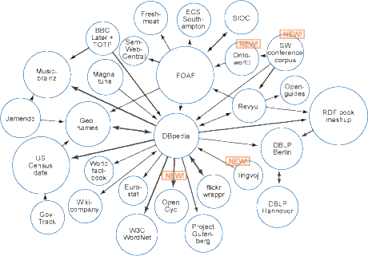
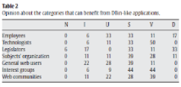
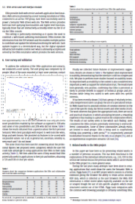
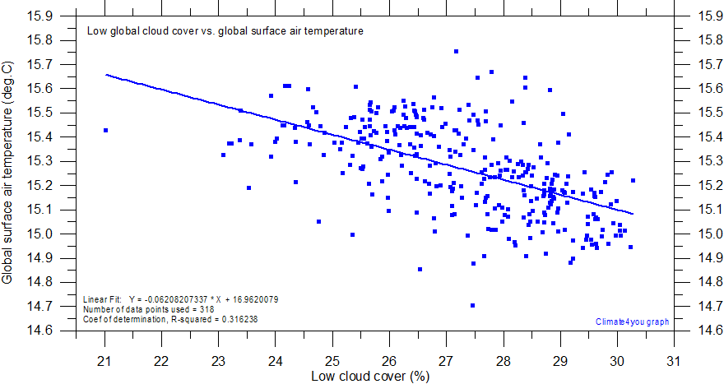
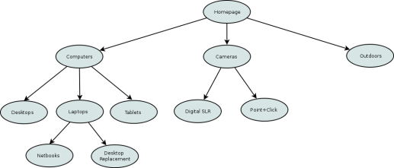
An Enterprise Knowledge Graph
Unstructured/Semistructured content
Relational DB
External Domain Data
Align →
Tables
Data Graphs
References, Key Concepts, Relations
Customer Data
Enrichment and Encoding via Domain Ontology
Knowledge Graph
Search++
Recommendations
Vertical applications
Explorative interfaces

Slide 15
A knowledge refinery model
Sources
DataModel
Algorithms
Exploration/Validation
APIs →Production
Structure+Trust
Knowledge Graph zone
Structured data
+ Trust/Provenance
Validation/ Linking/Data fusion
RDF Analytics
→ Tests/Validations → Assisted Querying
SPARQL exploratory API
Freebase + Others
Wikipedia
Enhancements/Reasoning (by rules)
Neo4J
Schema.org OpenGraph
JSON-LD
Metadata Extraction, Label Propagation
Clustering/Classification
Giraph
Text content around OG/Schema
Text analytics
JSON/XML
Entity Recognition/
Semantic Lifting
Texts in posts Open Web content
HBase
Knowledge Workflow

Slide 16
Full processing
Sindice contributions to an advanced Knowledge Graph Pipeline:
recompute
Load to production
Explore
Transform
Extraction
Preliminary cleanup
Data Model
Hadoop RDF Summaries
Assisted Querying
Relational data browser
SEARCH! Semistructured Search/Rank
NoSQL, SQL
Triplestores connectors
Relational Data Browser
Alignment
Enrichment (Ontology/Rules)
Hadoop Transformations
Delta path
Search

Slide 17
Graph Knowledge Data Model
 | Classic Graph Theory | Knowledge Graphs
Nodes/Edges | 1 type , 1 edge | Thousands of types and edges, node properties
Typical queries/scenarios | Mapping distances between entities, asking shortest path, graph traversals etc | Mapping complex relational data, allowing for arbitrary knowledge. Ad hoc/BI kind of queries. Fixed path
Management needs | Generally simple | Distributed sources, Ontologies,
Typical Tools | Graphstores: Neo4J, Giraph | RDF/Triplestores/Sparql
Analytics/Processes | Metrics/Centrality/Classification/Label propagation etc.. | Data Graph Summaries

Slide 18
Full processing
Our contribution to an advanced Knowledge Graph Pipeline:
recompute
Load to production
Explore
Transform
Extraction
Preliminary cleanup
Data Model
Hadoop RDF Summaries
Assisted Querying
Relational data browser
SEARCH! Semistructured Search/Rank
NoSQL, SQL
Triplestores connectors
Relational Data Browser
Alignment
Enrichment (Ontology/Rules)
Hadoop Transformations
Delta path
Search

Slide 19
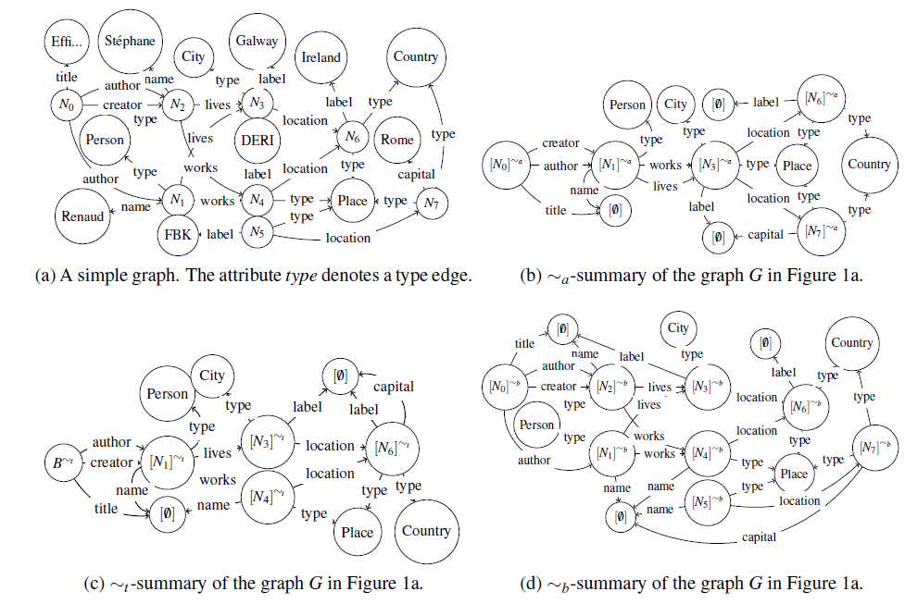
Example Knowledge Graph “Summaries”
Snapshot from UI showing the RDFa knowledge scraped from BBC.CO.UK in the Sindice.com search engine (total Sindice.com graph size, about 30b edges)
A small Knowledge Graph (figure A) and 3 alternative summary representations (b,c,d)
http://107.178.212.248
From "Efficiency and Precision Trade-Offs in Graph Summary Algorithms“ S.Campinas, R. Delbru, G. Tummarello
IDEAS 2013 ( Best paper award)

Slide 20
Graph Summary - Background
A type of analytics to extract structural properties.
Note: Structure is not just schema!
We apply it on “schema” in our examples
Can be applied on “values” thus a “cluster” can be arbitrary
Bisimulation / DataGuides: structural summaries for graph/semistructured data
Optimising query processing
Data exploration / analytics / bottom up ontology extraction
Formulating meaningful queries
Computationally expensive (!) for large graphs

Slide 21
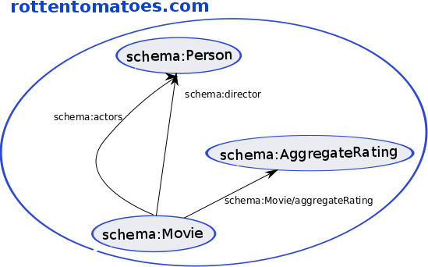
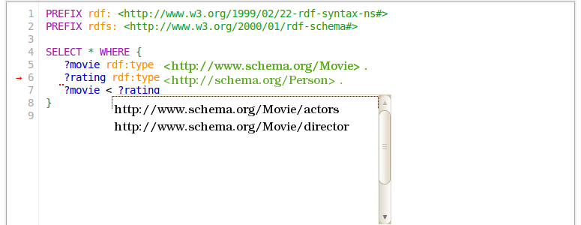
Assisted SPARQL Query Editor
schema:Person/name
schema:Person/url
schema:Person/image
schema:AggregateRating/reviewCount
schema:AggregateRating/bestRating
schema:AggregateRating/ratingValue
schema:Movie/genre
schema:Movie/image
schema:Movie/description
http://107.178.212.248/freebase/SparqlEditor/

Slide 22
Full processing
Our contribution to an advanced Knowledge Graph Pipeline:
recompute
Load to production
Explore
Transform
Extraction
Preliminary cleanup
Data Model
Hadoop RDF Summaries
Assisted Querying
Relational data browser
SEARCH! Semistructured Search/Rank
NoSQL, SQL
Triplestores connectors
Relational Data Browser
Alignment
Enrichment (Ontology/Rules)
Hadoop Transformations
Delta path
Search

Slide 23
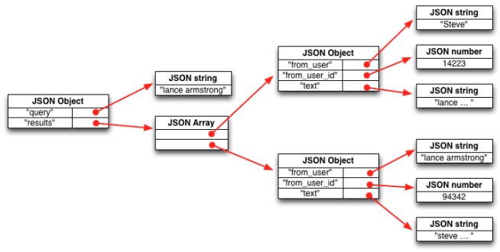
Semistructured Search
Bridging Structured and Unstructured data
Application example:
Reducing queries that fall back to web search
..by supporting queries that span structured & unstructured/textual data
SindiceTech’s Siren is likely the most advanced semistructured search engine implemented today

Slide 24
SIREn specializes in semi-structured search over nested / mixed content → JSON, XML
Fastest & Most scalable search method available, only known high performance implementation.
Available for Solr and ElasticSearch

Slide 25
Under the hood: SIREn
Inspired from tree-labelling scheme techniques (XML IR)
Label each node with a hierarchical ids (here Dewey’s identifiers)
Full-text search operators over the content of a node
Structural search operators over the nodes of the tree
Ancestor-Descendant, Parent-Child, Sibling, …
Positional search operators over the content and the nodes
Highly efficient implementation, custom file structure, compression, production grade.
Special ranking, BM25MF keeps structure in full account

Slide 26
Under the hood: Tree-Labelling
{
"name" : "LucidWorks",
"category_code" : "analytics",
"funding_rounds" : [
{
"round_code" : "a",
"raised_amount" : 6000000,
"funded_year" : 2009,
…
},
…
]
}
name
LucidWorks
funding_
rounds
round_
code
a
raised_
amount
6000000
…

Slide 27
Under the hood: Tree-Labelling
{
"name" : "LucidWorks",
"category_code" : "analytics",
"funding_rounds" : [
{
"round_code" : "a",
"raised_amount" : 6000000,
"funded_year" : 2009,
…
},
…
]
}
1
name
LucidWorks
1.1
1.1.1
funding_
rounds
1.2
1.2.1
round_
code
a
1.2.2.1
1.2.2.1.1
raised_
amount
6000000
1.2.2.2
1.2.2.2.1
…
1.2.2

Slide 28
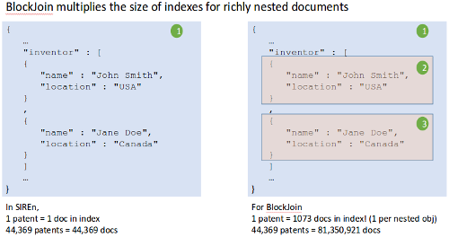
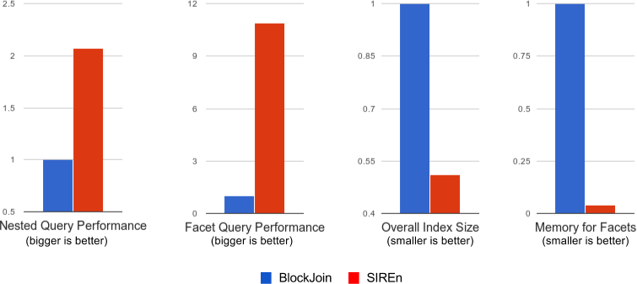
Performance
Siren Vs Blockjoin (Elasticsearch/Solr)
USPO XML files

Slide 29
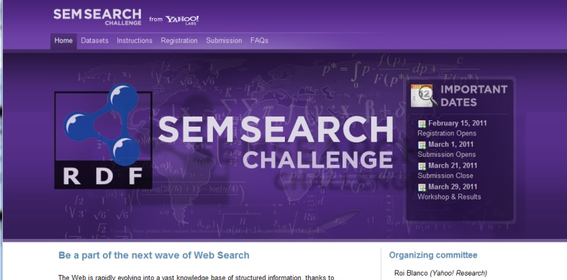
SIREn ranking winner Yahoo SemSearch Challenge
BTC dataset created from web crawls
Billion of triples, Hundreds of millions of entities
Real world Entity search queries from Yahoo
Result achieved via query time “BM25MF” alone (!)

Slide 30
Full processing
Our contribution to an advanced Knowledge Graph Pipeline:
recompute
Load to production
Explore
Transform
Extraction
Preliminary cleanup
Data Model
Hadoop RDF Summaries
Assisted Querying
Relational data browser
SEARCH! Semistructured Search/Rank
NoSQL, SQL
Triplestores connectors
Relational Data Browser
Alignment
Enrichment (Ontology/Rules)
Hadoop Transformations
Delta path
Search

Slide 31
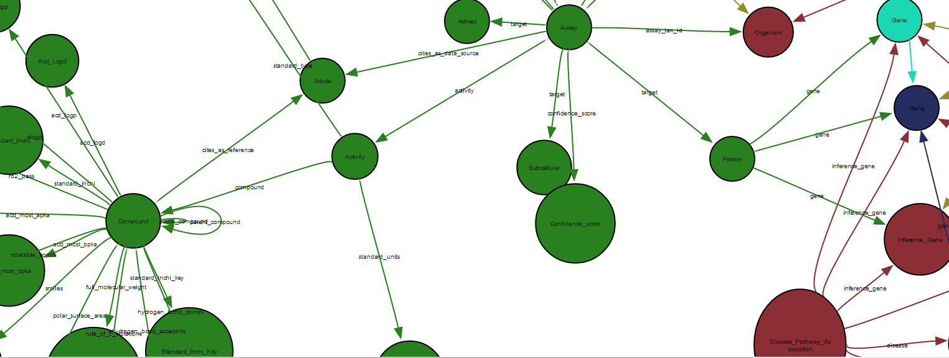
Interactive Relational Data Navigation
Notes:
PivotBrowser offers advanced Faceted Browsing making use of the relationships between entities.
A path in the data can be selected and visualized as a tabbed “Pivot View”. From this view, one can browse and restrict not only based on properties of the entities (traditional faceted browsing) but also based on properties of connected entities, and this up to several “degrees of separation away”.
The result, is effectively an interactive, visual way to query and understand complexly interrelated data.
PivotBrowser is a Patent Pending SindiceTech innovation.

Slide 32
Summary
Presented reusable ideas and tech derived from Sindice.com
Ideas on a big data/knowledge graph pipeline
Knowledge Graph analytic (summary graph) and applications
Siren advanced search engine for mixed structured/unstructured data
PivotBrowser big data→semistructured search→ realtime UI

Slide 33
Thank you
Useful links
Sindice story blog post http://semanticweb.com/end-support-sindice-com-search-engine-history-lessons-learned-legacy-guest-post_b42797
Siren http://sirendb.com
Any23 http://any23.apache.org
Publications
R. Delbru, S. Campinas, G. Tummarello. Searching Web Data: an Entity Retrieval and High-Performance Indexing Model. Journal of Web Semantics, 2011.
G. Tummarello, R. Cyganiak, M. Catasta, S. Danielczyk, R. Delbru, S. Decker. Sig.ma : Live views on the Web of Data. In Journal of Web Semantics, 2010
R. Delbru, G. Tummarello, A. Polleres. Context-Dependent OWL Reasoning in Sindice - Experiences and Lessons Learnt. International Conference on Web Reasoning and Rule Systems (RR). 2011.
S. Campinas, T. E. Perry, D. Ceccarelli, R. Delbru and G. Tummarello. Introducing RDF Graph Summary With Application to Assisted SPARQL Formulation. (DEXA). Vienna, 2012.]
Campinas, R. Delbru, G. Tummarello. Effective Retrieval Model for Entity with Multi-Valued Attributes: BM25MF and Beyond. EKAW 2012.
R. Cyganiak, H. Stenzhorn, R. Delbru, S. Decker and G. Tummarello. Semantic Sitemaps: Efficient and Flexible Access to Datasets on the Semantic Web. ESWC. 2008.

